Slide 1

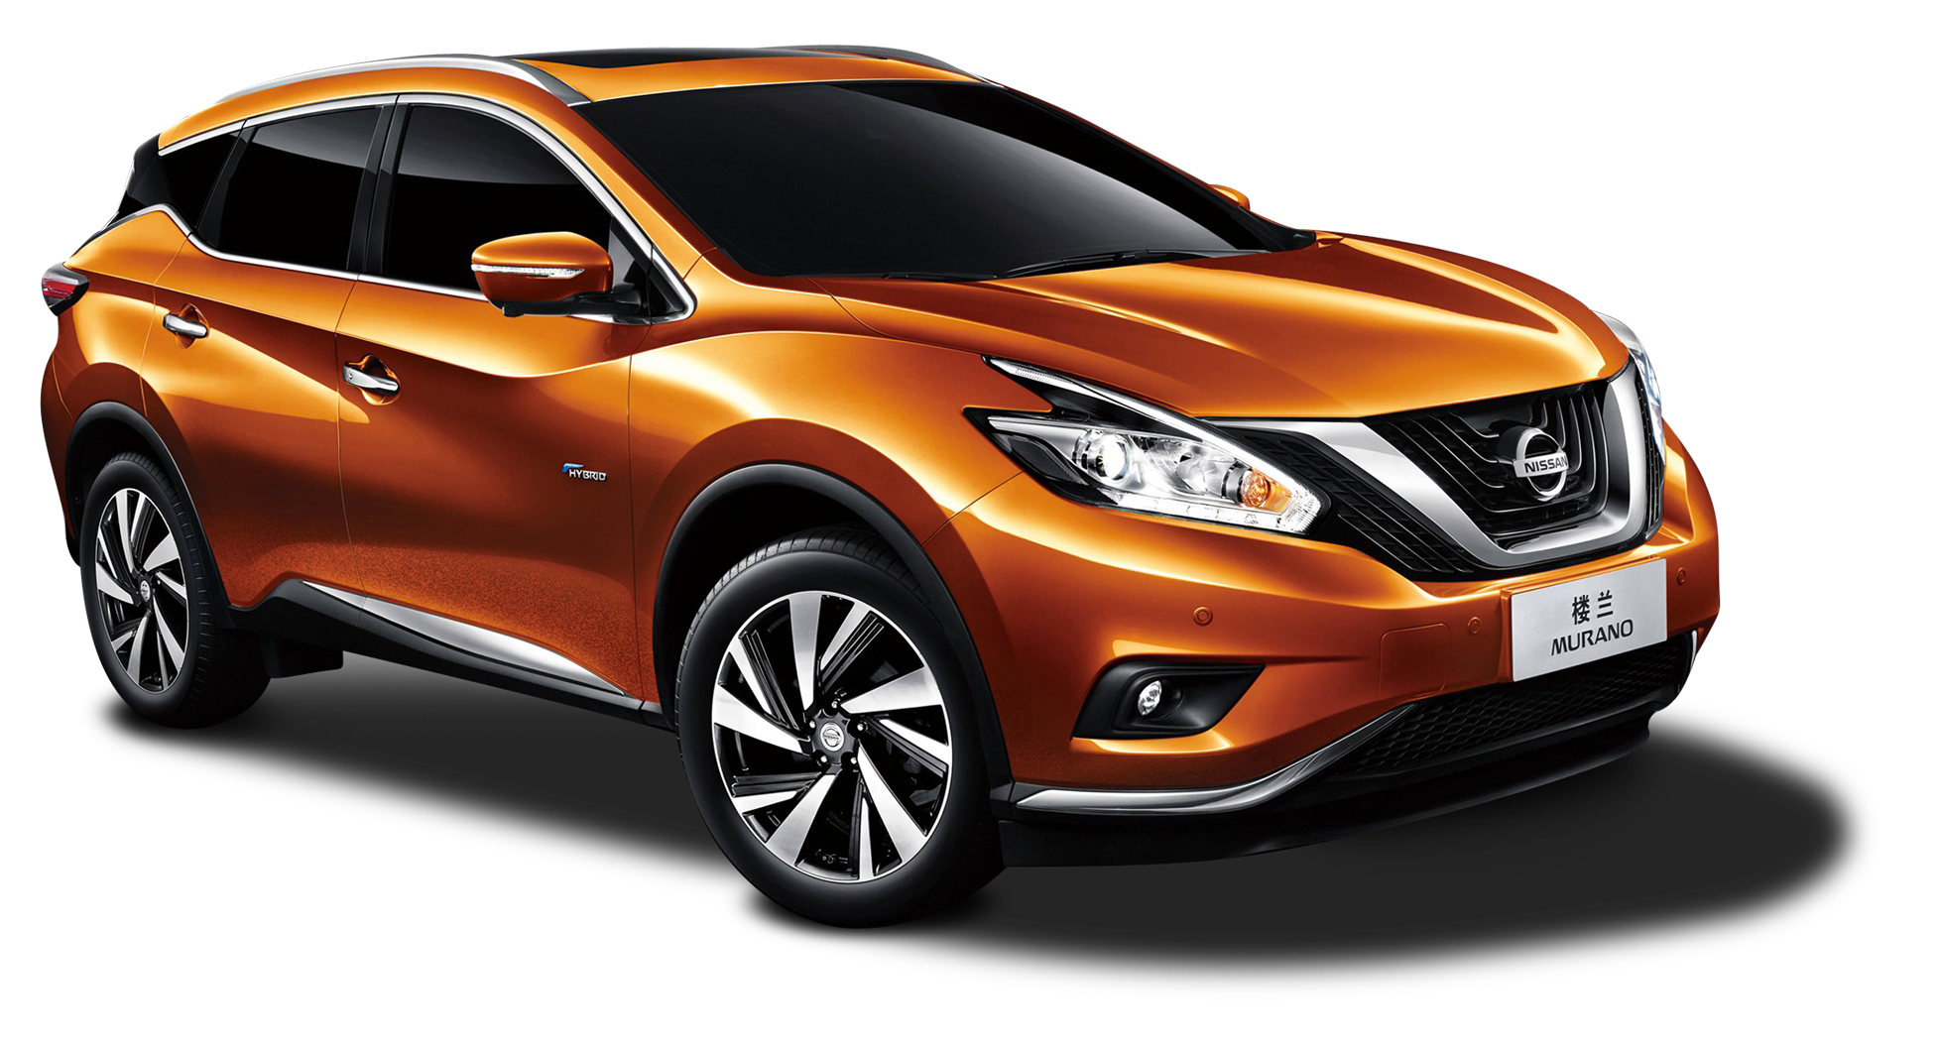

Nissan's Product Lineup
Aruvi B
21AUR003

Slide 2
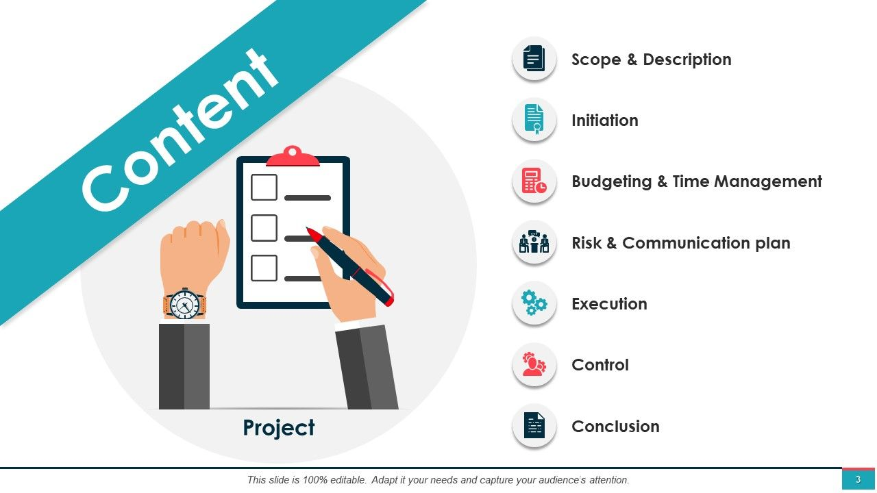

History
CEO
Nissan outlook
LOGO
Models
SWOT
Location & updates

Slide 3
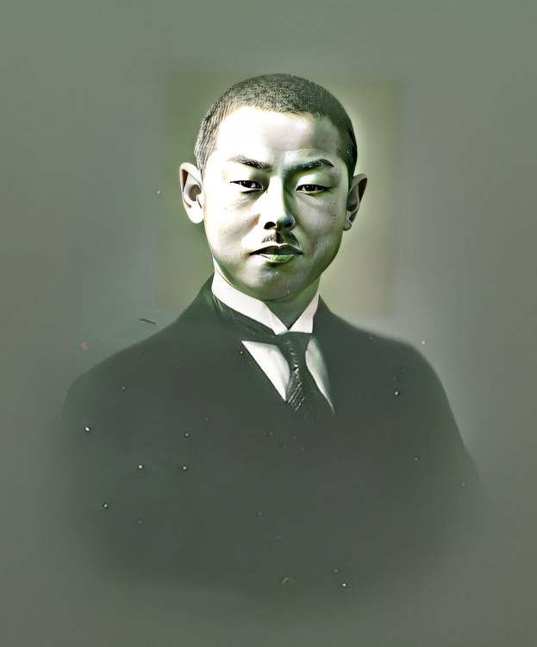

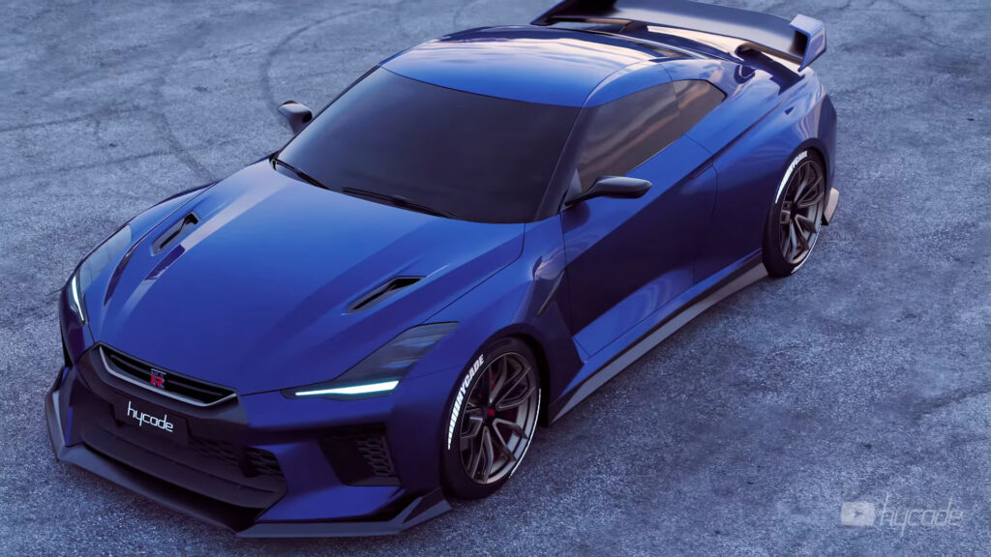
Nissan’s history
Nissan was established on December 26, 1933.
Founder is Yoshisuku Aikawa.
Began its business operation in Malaysia since 1950 in Tan Chong Motors as vehicle distributor.
Provided diverse range of products such as cars, trucks, forklifts, and motorboats.
Nissan ranked number 5 in Malaysia automotive industry.

Slide 4
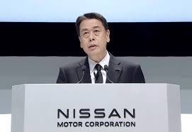
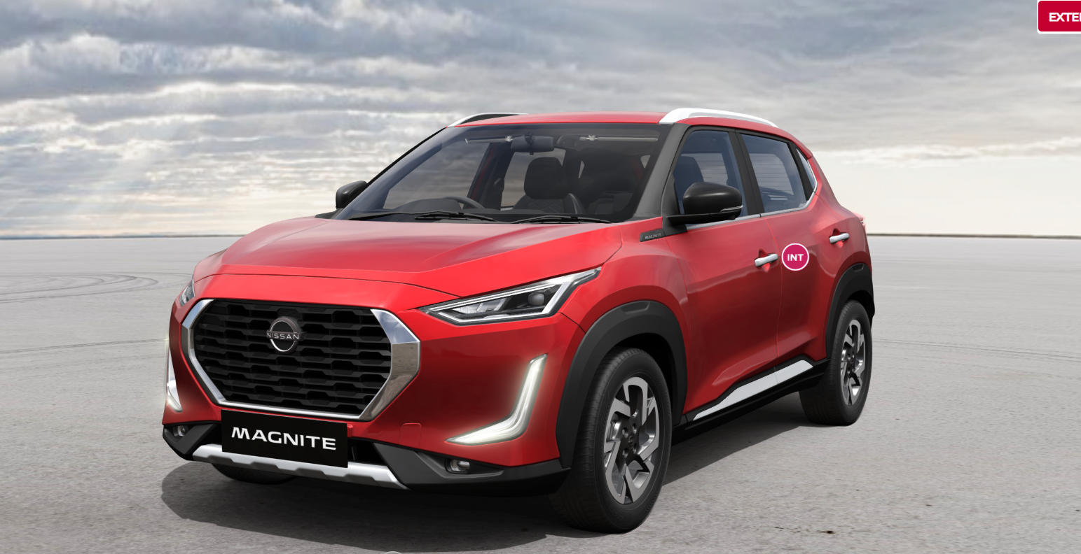
CE0
Makoto Uchida is a Japanese businessman who is the current CEO of the Nissan Motor Company, Ltd.
In 1991, Makoto Uchida joined Nissan corporation. After 2019, he is representative executive officer, president and CEO, Nissan Motor Corporation, Ltd.

Slide 5
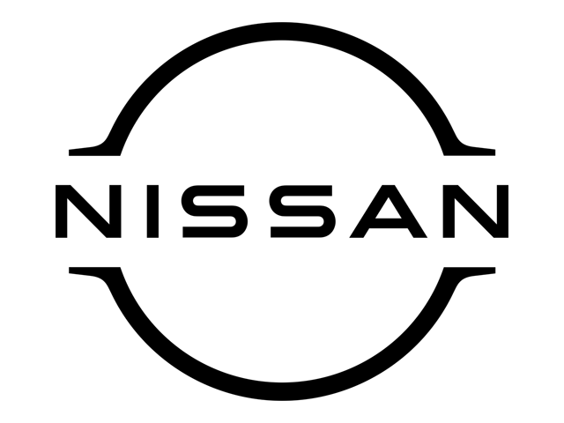
Nissan outlook
Nissan’s strategy is to focus on the customer experience.
The company wants to create a seamless experience across all channels, from online to offline.
Nissan is investing in technology and innovation to create more efficient and sustainable vehicles.

Slide 6
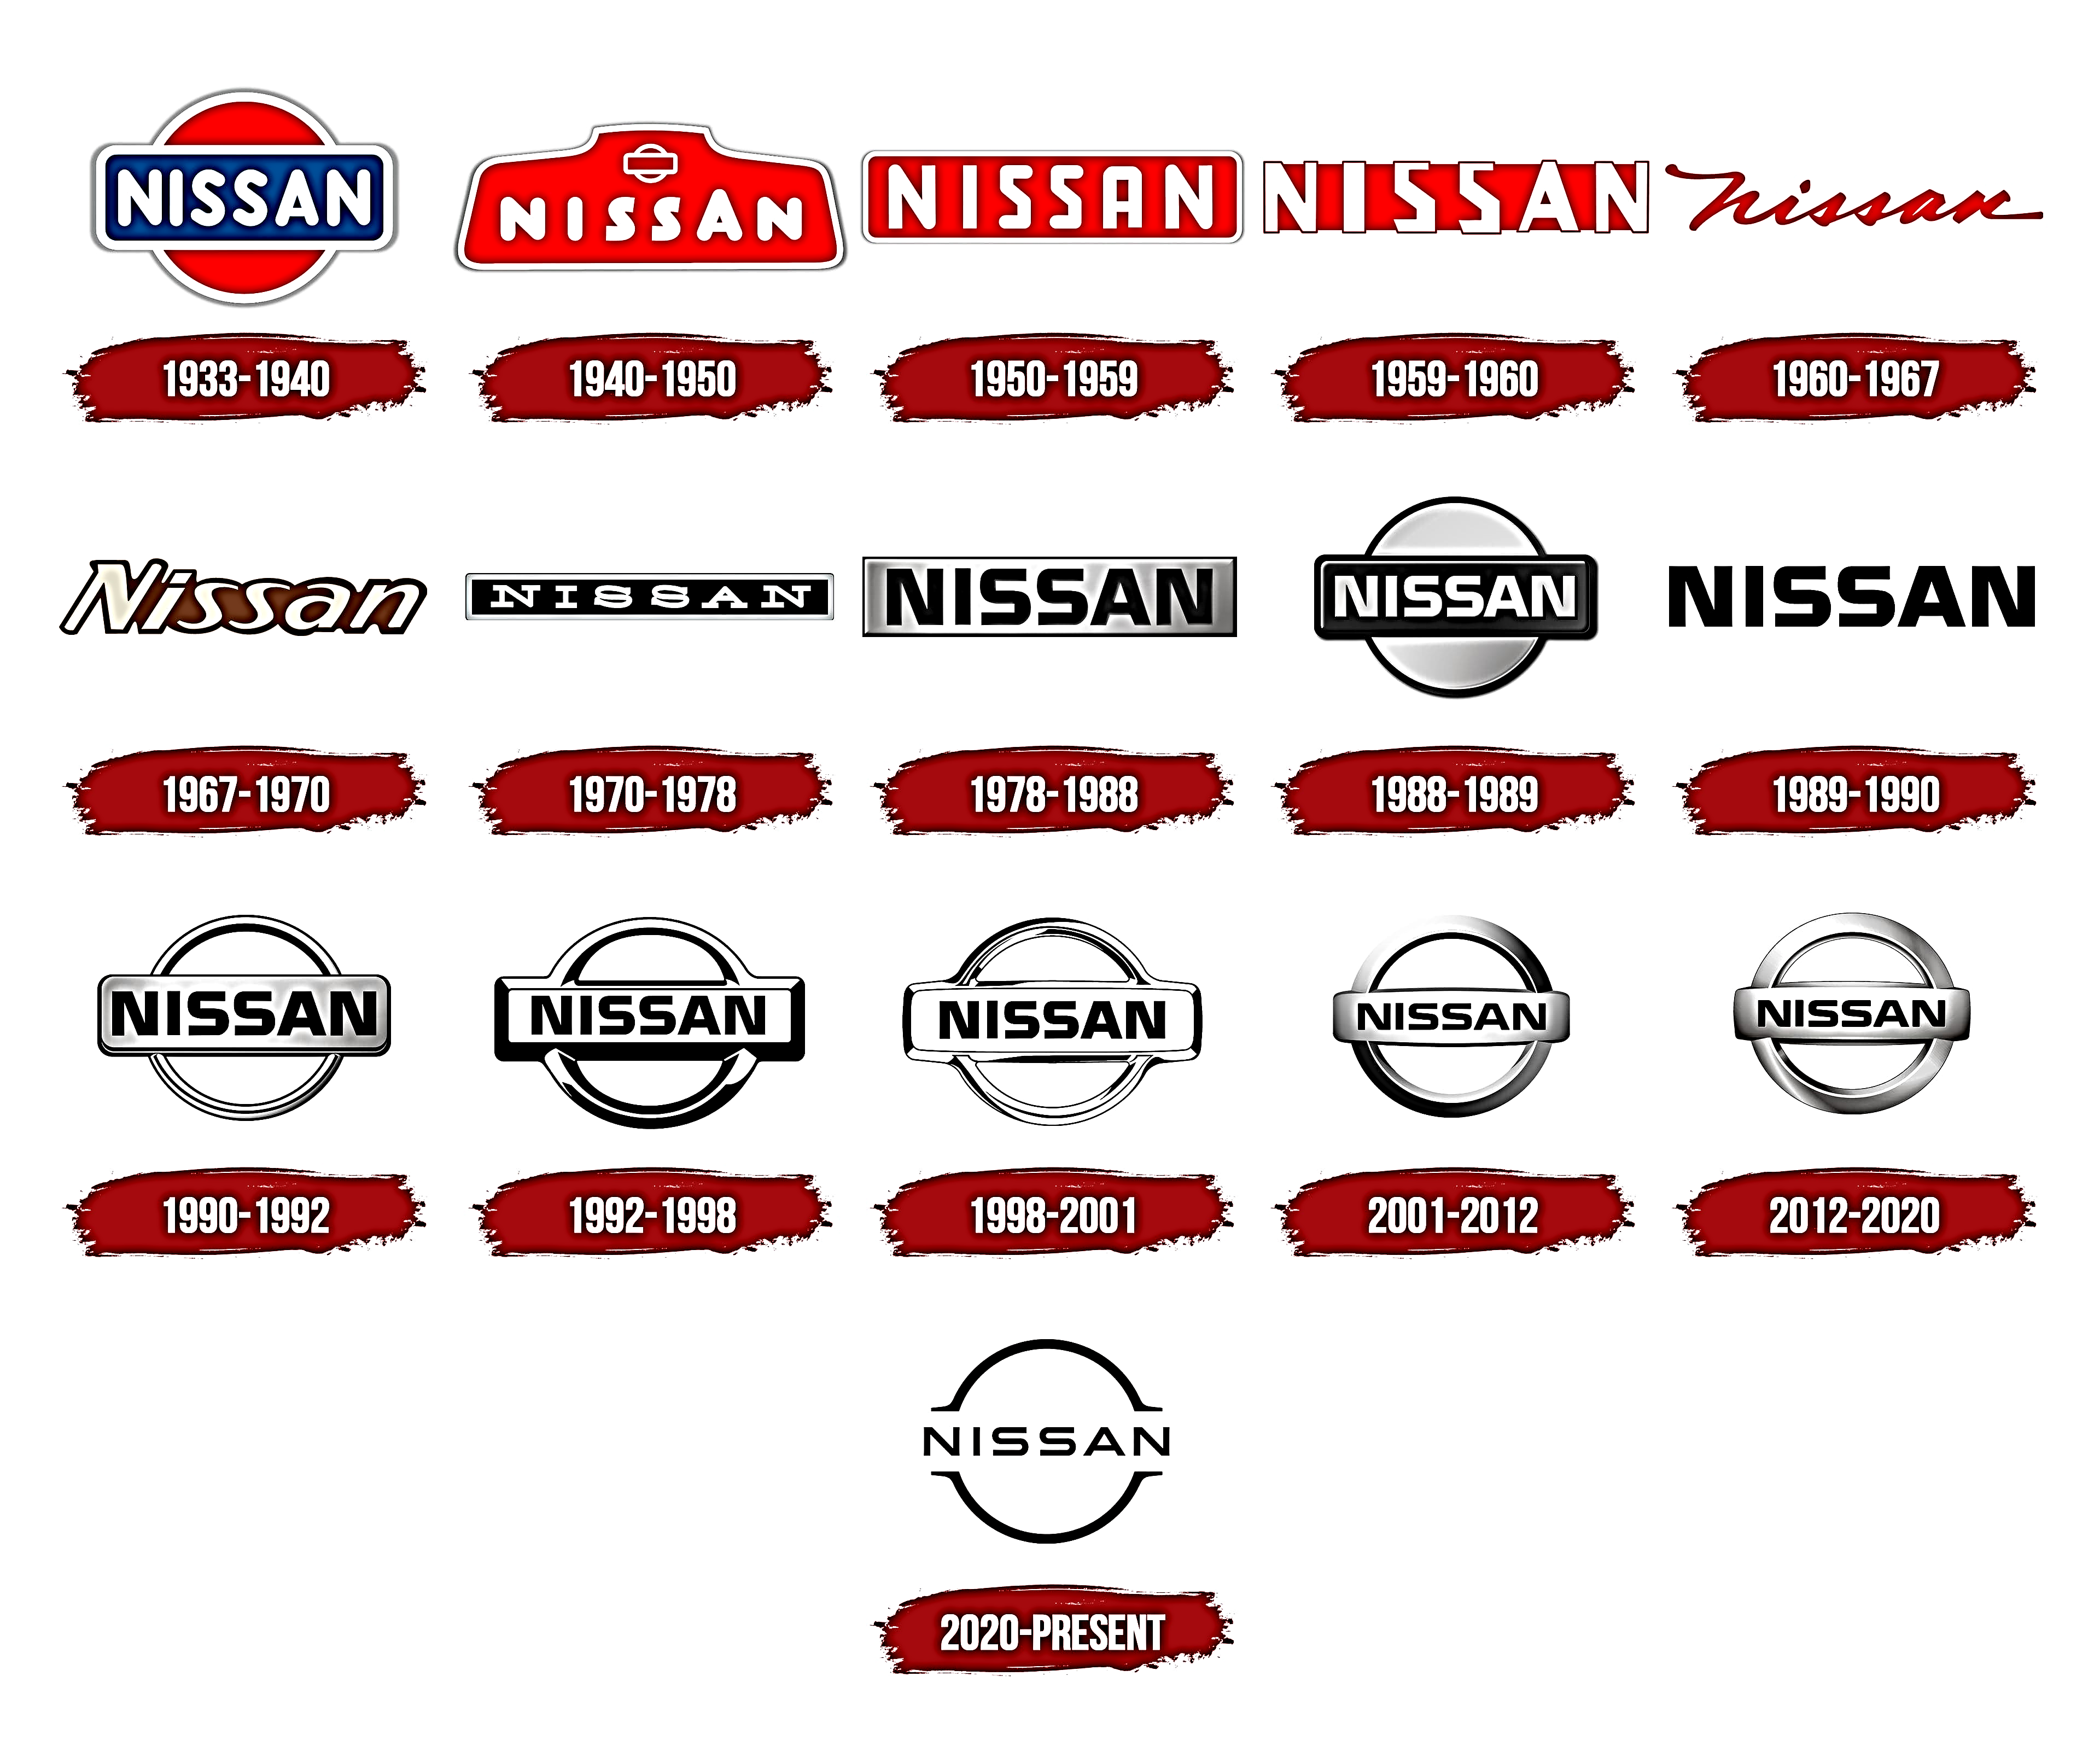
LOGO evaluation
At present

Slide 7
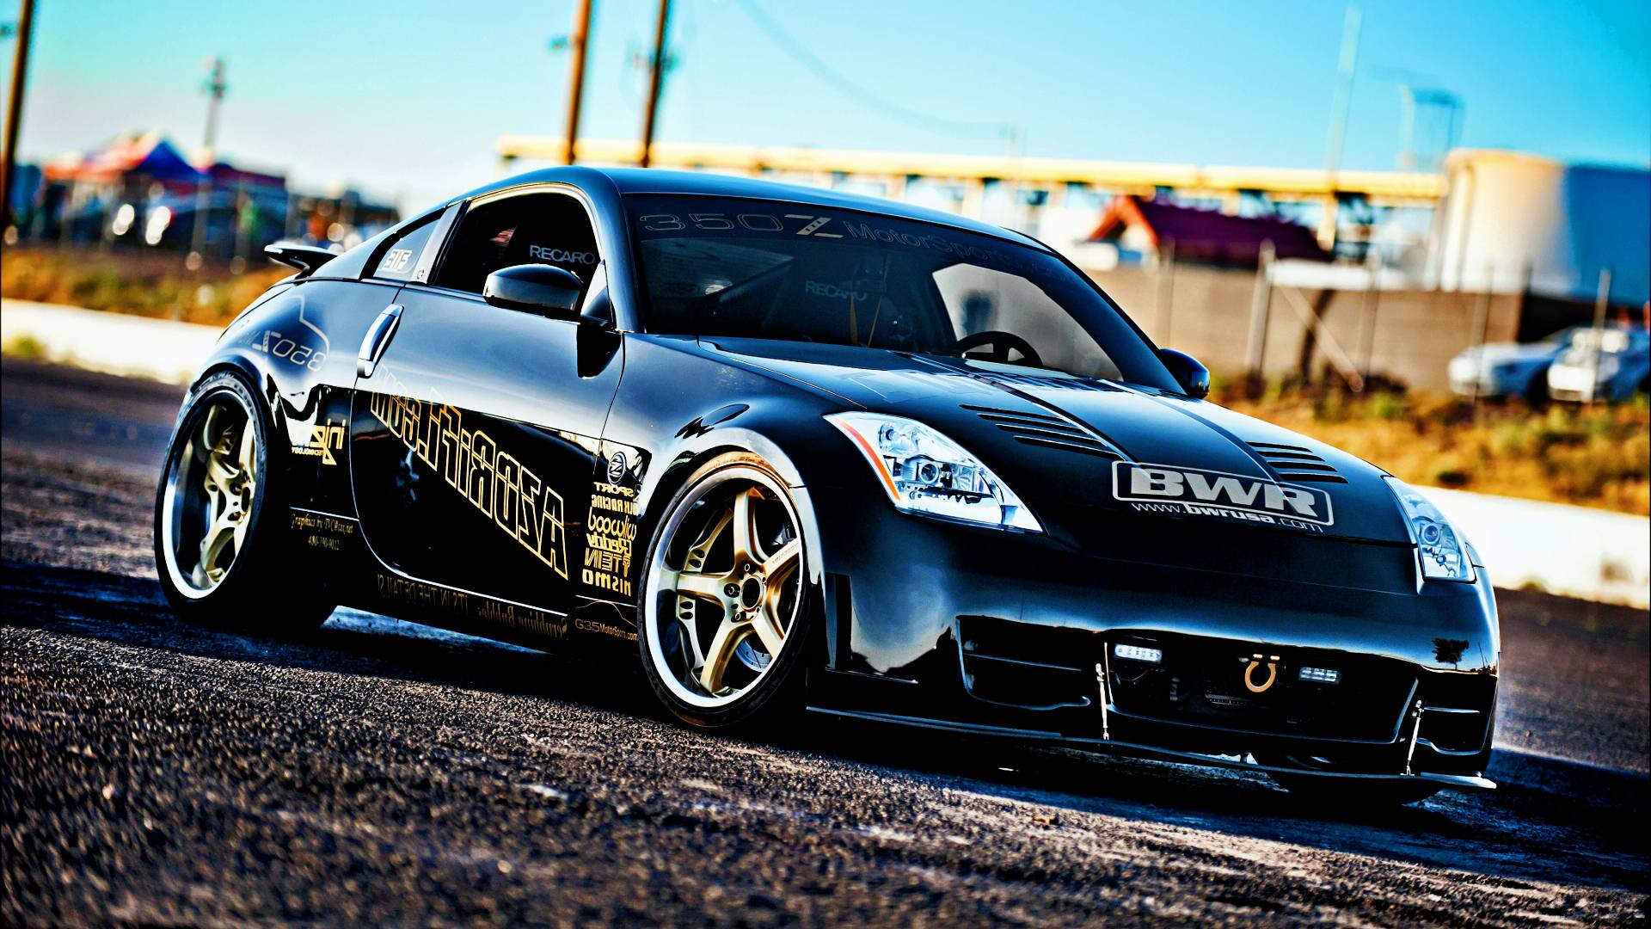
ICONIC Models
NISSAN Skyline GTR R34
NISSAN 350Z
NISSAN 370Z
NISSAN Silvia S14 or Nissan 200SX in Europe
NISSAN GT-R R35
NISSAN 350Z

Slide 8
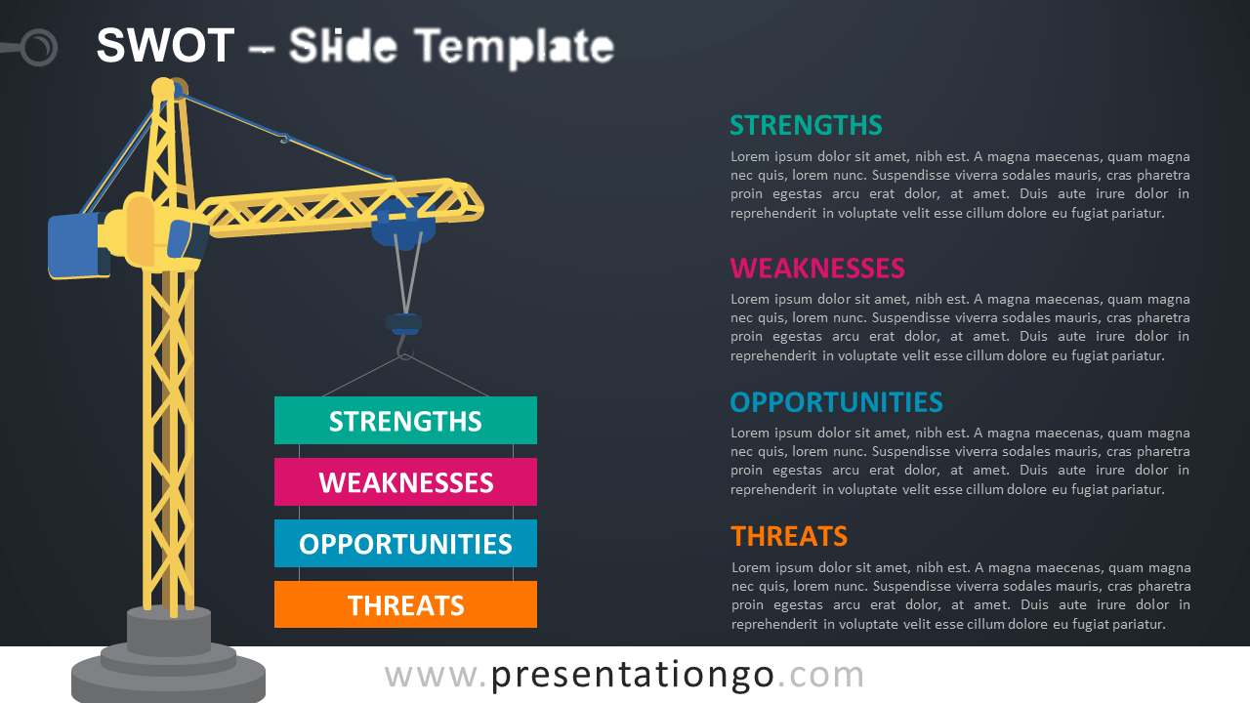
SWOT
STRENGTHS
Brand Equity, Technological innovation, Large Product Portfolio, Strong Cash Flow
WEAKNESS
Product Recalls, Management issues
OPPORTUNITIES
Asian Markets, Electrified Cars, Research and Innovation.
THREATS
Regulatory threats, Competition, Changing Industrial Environment

Slide 9
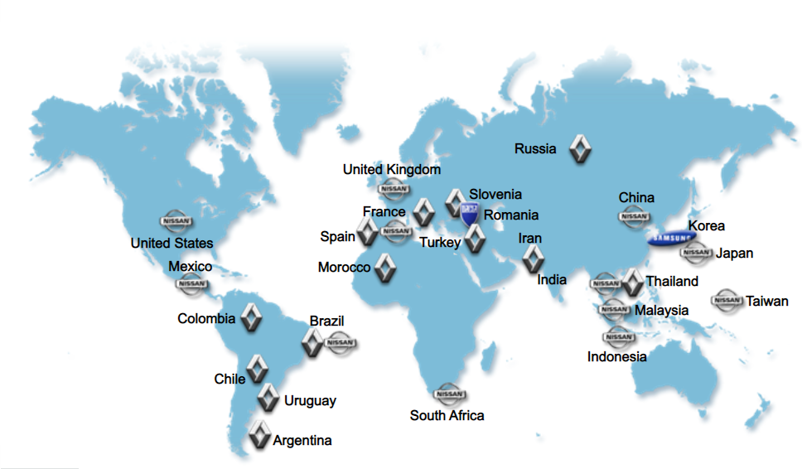
Company locations

Slide 10

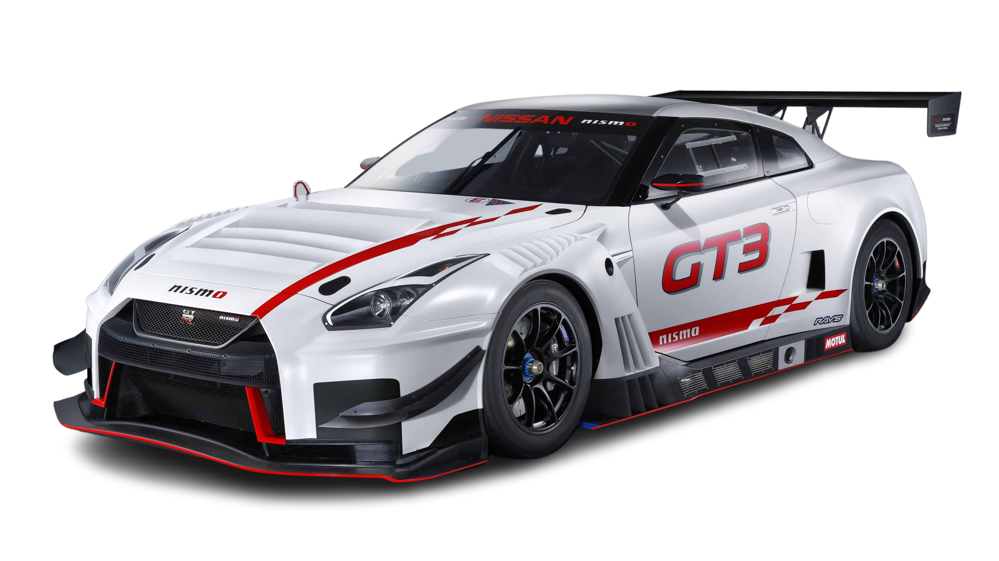
Future updates
AI evaluation system – a glimpse of what’s possible
Headed by project lead, Yoshinori Sato, a team of Nissan engineers has, since 2018, been working on ways to introduce cutting-edge AI (Artificial Intelligence) technologies to car manufacturing in Japan.
It gave 99.995% accuracy on 2018

Slide 11

Thank You

